Slide 1
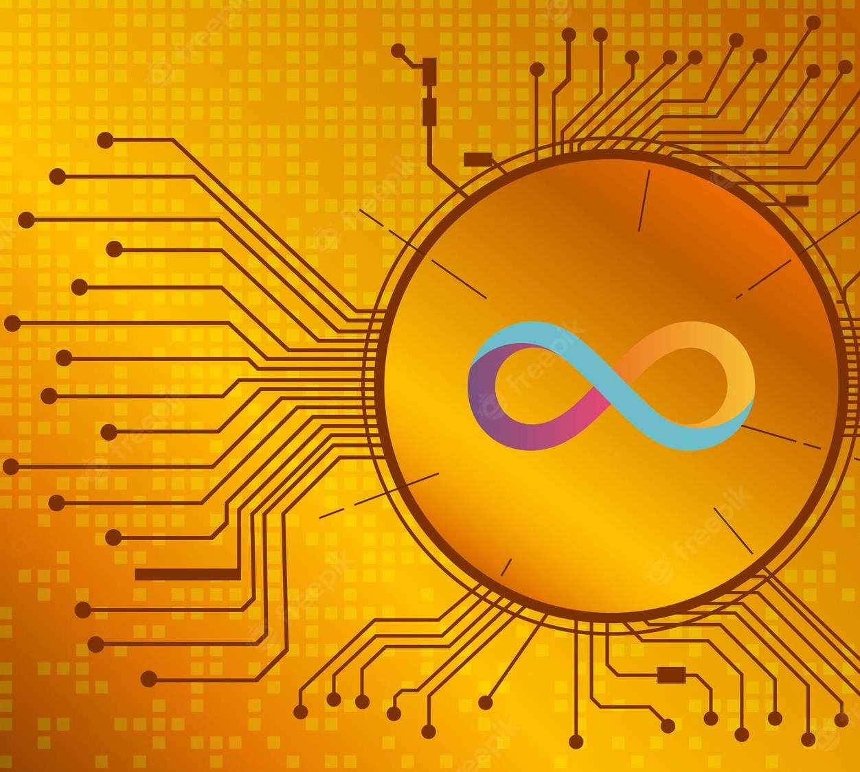
Unbroken Token
Presented by :
Jason
Majid
Toni
Ragini
Dan
Steven

Slide 2
Table of Contents
Scope and Purpose
Project Approach
Techniques used
Code Demonstrations
Challenges
Results (Demo)
Shortcomings (Failed to achieve)
Conclusions
Next Steps

Slide 3
Scope and Purpose
Similar to the UK Premium bonds but significantly riskier
Buy a token using ETH (works as a “ticket”)
Receive a token of UBT
ETH was gathered and staked in central account
Staking profits are sent to a central accounts
The central account’s earnings are distributed at random to 5% (+-) of UBT token holders each month (or day or week)

Slide 4
Project Approach
Python & Streamlit: For deploying the app
Dotenv: For accesing the .env file
Web3: For Web3 & HTTPProvider
Solidity and Openzeppelin contracts: For Crowdsale and Token

Slide 5

Techniques Used
1. New token creation:
Solidity & remix
User inputs for initial supply, wallet and Crowdsale goal
Ganache used for sample accounts
2. ICO
Examined various launch tactics graduating price by time
Notes:
Update this from slack

Slide 6



Demonstrations
Notes:
Changes the image

Slide 7

Challenges
Notes:
Suggestions from team
Note: Updated from the ReadMe file

Slide 8
Results

Slide 9
Shortcomings

Slide 10


Slide 11

Next Steps
.

